Slide 1
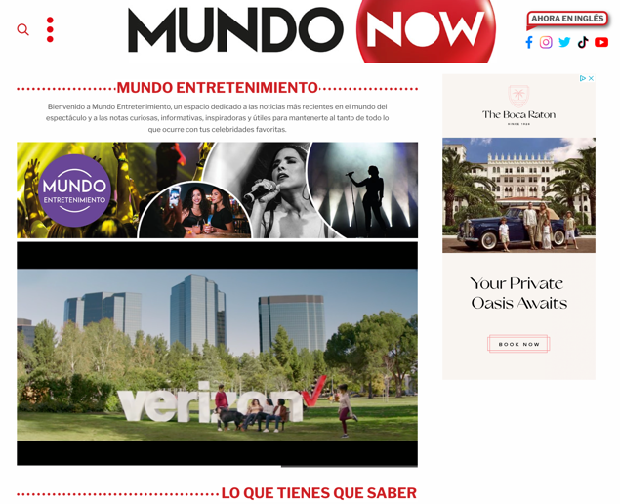
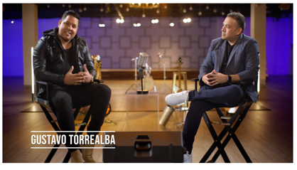
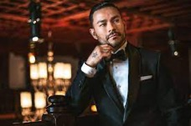
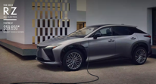
MUNDO MÚSICA: Powered by BRAND
Launch Partnership of Mundo Música vertical (May – July ’23)
100% SOV
Prominent Video Placement
Custom Video Production
Pre-Roll
Display
BRAND Lounge within Mundo Música to include:
1:1 Artist Interviews
Virtual Meet and Greet with Top-Tier Talent: ex. (Bobby Pulido, Bronco, Las Fenix, La Maquinaria Nortena).
Launch partner of Podcast: Cafecito Sessions with Frankie J.
Step and Repeat to be seen in video portion.
Live Reads, Pre-Roll + Midroll
Notes:
Slide – 6
Vertical Sponsorships (Headline)
Combine 3 Brands to show examples. Verizon, Toyota and Rocket Mortgage.

Slide 2
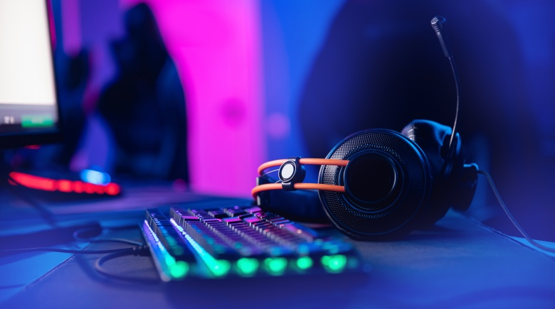
Podcast synopsis
Multi-Platinum artist, Frankie J Cafecito Sessions is a taped video and podcast show where fans will get an up close and personal acoustic performance along with a Q&A session at cafés in multiple cities.
metrics & analytics
Primary Demographic:
A18+
Live or Pre Recorded?
Pre-Recorded
Baked in or Dynamic
Dynamic: Per impression
Baked In: Flat Fee
Category:
Entertainment
Ads Length:
:15s, :30s, :60s
Cancellation Policy:
5 business days prior to start date
Language:
Spanish
Pricing:
CPM
Measurement type
IAB
Notes:
Slide – 6
Vertical Sponsorships (Headline)
Combine 3 Brands to show examples. Verizon, Toyota and Rocket Mortgage.

