Slide 1
OUR LATINO
BILINGUAL / BICULTURAL FUTURE,
HERE TODAY

Slide 2
MISSION, PURPOSE & CERTIFIED!
MundoNow has built an award-winning national reputation on our ability to reach Latino communities across America. First as MundoHispanico and our roots as the largest Spanish-language newspaper in the Southeast to today, where MundoNow has evolved into the largest bilingual/bicultural digital O&O platform in the USA, having recently added culturally relevant content in English to its Spanish-language offering. Ours is a platform Latinos can trust to innovate and provide information that educates, inspires, entertains and authentically connects to the entire spectrum of today’s dynamic Latino community.
MONTHLY STATISTICS*
NOTABLE BRAND PARTNERS
8.5MM
55MM+
9.8MM
570K
97%
UNIQUE USERS
PAGE VIEWS
FACEBOOK USERS
YOUTUBE FOLLOWERS
MOBILE
NOW FULLY BILINGUAL, Spanish + English
In Mid-2021 MundoNow began to publish content in English.
Since launch: 2MM Users per month serving 4MM pageviews.
*Sourced from MundoNow Google Analytics

Slide 3
RESPECTED VOICE ACROSS AMERICA
+ UPCOMING MEDIA GROWTH OUTLETS!
Since Digital-First Platforms were allowed to compete in 2018, MundoNow has won a total 16 Emmy’s since.
MAJOR
MARKETS
AWARDS &
ACCOLADES
The New York Times opened their season seven Op-Doc series with a documentary on Mundo and its approach to journalism & the Hispanic community. It premiered at the Tribeca Film Festival.
PODCAST NETWORK
LAUNCH!
JANUARY ‘23
Notes:
Side 4 – Award Winning Content (Headline)
Keep all of left side. Remove all of right side

Slide 4
LIFESTYLE
VERTICALS
Notes:
Slide 5 – MundoNow.com Lifestyle Verticals (Headline)
Good transition page into content from awards.

Slide 5
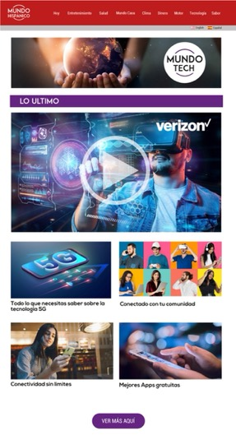
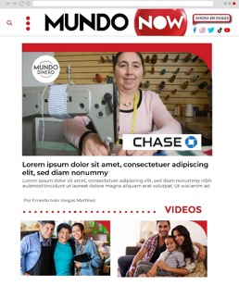
VERTICAL SPONSORSHIP: What Does This Look Like?
100% SOV, Prominent Video Placement, Custom Content - Articles & Videos, Display & Pre-Roll all share a role in effective content vertical sponsorship.
Notes:
Slide – 6
Vertical Sponsorships (Headline)
Combine 3 Brands to show examples. Verizon, Toyota and Rocket Mortgage.

Slide 6
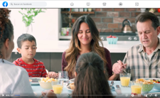
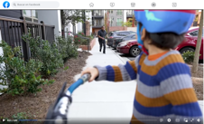
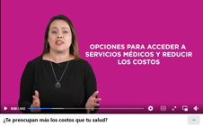
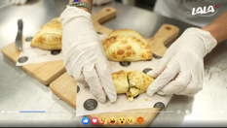
BRANDED CONTENT CAPABILITIES & OPPS
Based in Atlanta, a content production capital, MundoNow is primed to deliver custom content across a myriad of content verticals.

Slide 7
2022 BRANDED CONTENT PARTNERS
MundoNow has started 2022 strong with branded custom content deals with Rocket Mortgage, Coke, Crest and Verizon, producing video & articles bilingually.
In the case of Rocket Mortgage, Crest and Verizon, MundoNow launched new content verticals for the brands in the for of Casa, Tech and The Latina Mom Archive.

Slide 8
DEBUT LATINO PODCAST NETWORK
ÓYENOS AUDIO

Slide 9
New Hits Across Every Category
Society & Culture
Health & Wellness
Relationship Advice
Mysteries & Paranormal
Spiritual
True Crime
Entertainment

Slide 10
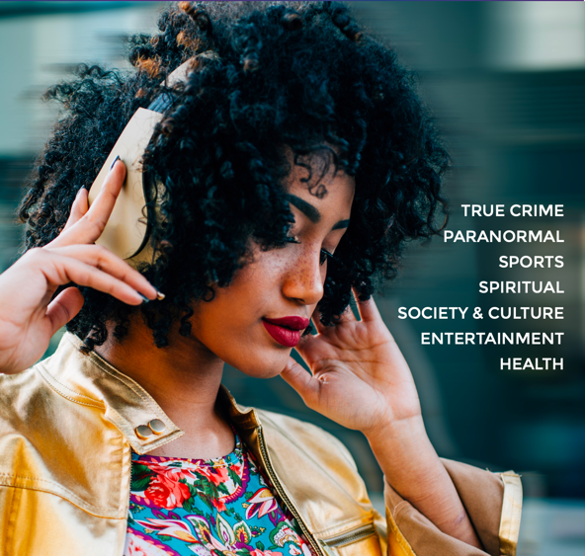
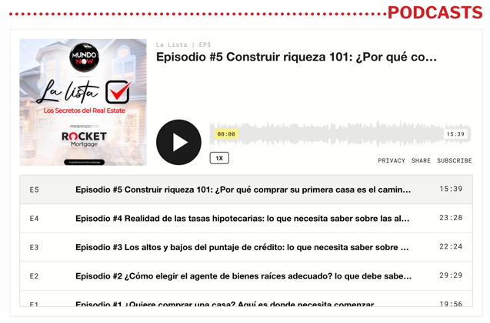
BRANDED PODCASTS
Óyenos Audio can provide full podcast production for brands from concept to delivery.

Slide 11
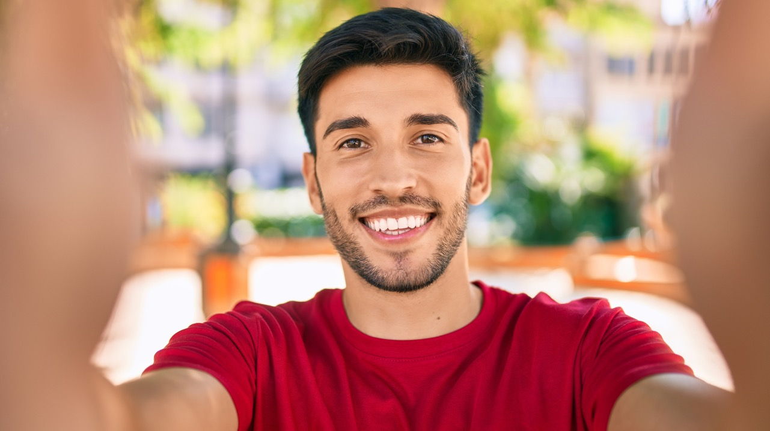
SOCIAL INFLUENCER OPPORTUNITIES

Slide 12
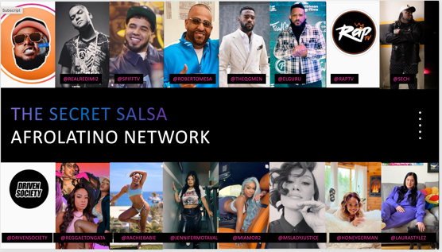
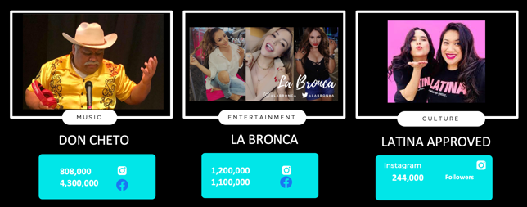
INFLUENCER NETWORK
GROW REACH & ENGAGEMENT!
MundoNow’s influencer network helps to amplify any messaging, across all media and social networks.
Brands can rest assured that their goal KPI’s reach the highest level possible.

Slide 13
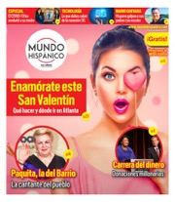
MundoNow ’23 Content Calendar to Include:
JULY
4th of July
Summer Vacation
AUGUST
Back to School, Latin Food Spotlight
SEPTEMBER
Fall Fashion, Hispanic Heritage Month
OCTOBER
Halloween,
Día de los Muertos
NOVEMBER
Thanksgiving, Spotlight, Latin Grammy’s
DECEMBER
Holiday Shopping, Tech
& Fashion
JANUARY
Diet & Fitness, Óyenos Audio Podcast Network Roll-Out (Verticals - True Crime, Relationships, Paranormal, Society/Culture, Entertainment, Pop Culture, Spirituality)
FEBRUARY
Super Bowl
Valentine’s Day (MundoAmor)
Óyenos Audio Podcast (Verticals- Sports, Health).
MARCH
Women’s History Month
MundoKids Vertical Debut
APRIL
Easter, Spring Fashion, MundoInspira vertical debut
MAY
Mother’s Day, Graduation, MundoMusic debut
JUNE
Father’s Day, Juneteenth/Afro-Latino Celebration, MundoBusiness entrepreneur vertical debut.
z
Q1/Q2 2023 CONTENT VERTICAL
SPOTLIGHT
…………………………….........................
March
February
April
May
January
June
Notes:
Slide 3 – Largest Independent Minority-Owned Digital Platform (Headline)
Key Differentiator from our competitors – Reach + Scale

Slide 14
Mundo Now Audience: US HISPANIC, Bilingual/Biculturals
Measurement capabilities range from client-preferred to industry standard.
We let advertisers use any measuring third-party partner of their liking. All major companies like IAS, MOAT, DV, and Nielsen are supported.
On our side, we use Google Ad Manager Reporting. We can provide Active View, Viewability, Completion Rate Stats, and many other standard metrics.
We also use Google Analytics and ComScore for traffic and audience data.
SIZE OF AUDIENCE:
Unique Users: 9.8MM
Pageviews: 55MM
Time on site: 1:18 average length per session
TOTAL IMPRESSIONS:
Display: 200 Million per Month
Video: 15 Million per Month
CTR:
Display: 0.12%
Video: 0.53%
Notes:
Side 4 – Award Winning Content (Headline)
Keep all of left side. Remove all of right side

Slide 15
MUNDO’S THREE MEASURED PILLARS:
What Makes US Different from Competitors?
1 Multi-Channel Reach +
Custom Content Creation
in Key Verticals
2 At Scale Display + Pre-Roll Impressions Served by Premiere AdOps Expertise
3 Social Media Reach +
Engagement Across Mundo Ecosystem
COMING SOON!
PMP Deal Integration via Google, Xandr, Pubmatic, and various SSPs.
Contextual Targeting (Category Targeting) via Custom Key Values.
Ad Position Targeting, Adhesion high viewability position >90% available.
Maximizing CTR via Monitoring reports and targeting areas where you are performing best.

Slide 16
Point of Contact:
Andrew Polsky, CRO: Apolsky@MundoNow.com

