Slide 1
LATINO ALTERNATIVE TV

Slide 2
TABLE OF CONTENTS:
BLACK HISTORY MONTH 23
WOMEN’S HISTORY MONTH 23
EARTH DAY SPECIAL 23
QUEST TO QATAR 22
HISPANIC HERITAGE MONTH 22
LATINO BUSINESS FORUM 22
PRIDE MONTH 23

Slide 3
Throughout the month February, LATV with be celebrating Black History and Afro-Latino History. Special programming will be featured on Premium LATV shows including Cultura Shock, The Q Agenda, Shades of Beauty and Blacktinidad. Content across these shows will focus on empowerment, education and celebration throughout the month.
This campaign will be cross-promoted and distributed throughout all LATV series and platforms.

Slide 4
Cultura Shock:
½-Hour Black History Month Special
Monday, Feb 6th, 4pm PT / 7pm ET
Cultura Shock focuses on aspects of Latino culture not seen anywhere else.
LATV’s Anakaren Lopez brings you an electrifying and refreshing perspective as to what Latino cultura looks like in modern day America.
Blacktinidad:
½-Hour Black History Month Special
Friday, Feb 10th, 4pm PT / 7pm ET
Blacktinidad crosses boundaries with it’s pressing subject matters and retable conversations. Join our hosts as they dare to ask the questions many wouldn’t. Accompanied by experts in the various
subject matters, Blacktinidad offers great insight on Latinidad, Afro-latinx culture and more… Kick it with us on Blacktinidad every week only on LATV.

Slide 5
The Q Agenda:
½-Hour Black History Month Special
Thursday, Feb 16th, 4pm PT / 7pm ET
An LGBTQ series where being brutally honest is an understatement. Enrique, Juliana, Victor and Lianna provide us with honest and funny conversation on news, politics & social trends and Entertainment and how they affect the LGBTQ community and their allies.
Shades of Beauty:
½-Hour Black History Month Special
Friday, Feb 24th, 4:30pm PT / 7:30pm ET
Shades of Beauty centers around Afro-Latina beauty, promises to offer out of the box inspiration as well as practical tips to have you feeling like your best self every day of the week. We touch on subjects that are relatable. We break down the beauty stereotypes that are all too prevalent in our current media landscape. Beauty is not one dimensional. Welcome to Shades of Beauty, where we celebrate all shades all the time.

Slide 6
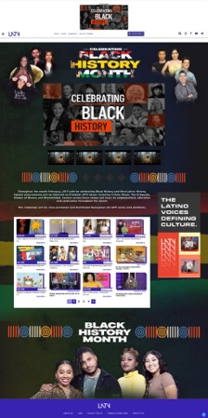
Digital Sponsorship Package deliverables:
Digital Content Sponsorships
2x custom Black History Month Articles
Sponsor Black History Month Section on LATV.com (Page takeover, sponsored video hub, sponsored editorial section (on for 5 days)
Media (100% endemic Afro Latino audiences)
Instream Video Impressions served on LATV.com & LATV Digital Network
OTT/CTV Video Impressions served on LATV+ & LATV OTT/CTV Network
Display Impressions served on LATV.com & LATV Digital Network
Total Estimated Impressions: 1,500,000
Investment Total:
Starting at $50,000
Limited to 3 Sponsors
Flight Dates: 2/1-2/28
Deadline sponsorship January 23rd

Slide 7
Linear Sample Schedule
2x - :30-second unit - ½ hour premiere BHM special of Shades of Beauty
2x in re-airs
2x - :30-second unit - ½ hour premiere BHM special of Blacktinidad
2x in re-airs
2x - :30-second unit- ½ hour premiere BHM special of The Q Agenda
2x in re-airs
2x - :30-second unit- ½ hour premiere BHM special of Cultura Shock
2x in re-airs
1x - :05 sec Billboards and :10 sec lower third per episode
Total 16 spots; 4 billboards/lower thirds in Black History Month specials
Investment Total: $25,000
Limited to 3 Sponsors
Deadline to celebrate Black History Month with LATV is January 23rd
Flight Dates: 2/1-2/28

Slide 8
Women’s History Month is an annual declared month that highlights the contributions of women to events in history and society. LATV will be celebrating Latinas, their contributions and legacy throughout the month. Special content across these shows will focus on empowerment, education and celebration.

Slide 9
Shades of Beauty:
Friday, March 17th,
4:30pm PT / 7:30pm ET
Shades of Beauty centers around Afro-Latina beauty, promises to offer out of the box inspiration as well as practical tips to have you feeling like your best self every day of the week. We touch on subjects that are relatable. Beauty is not one dimensional. Welcome to Shades of Beauty, where we celebrate all shades all the time.
Pinkafe:
Tuesday, March 7th,
4pm PT / 7pm ET
Pinkafe is a weekly series of fun conversations that explore the personal & professional experiences of powerful women, including entrepreneurs who created their business by expanding their side hustle.
Get it Girl:
Wednesday, March 15th,
4:30pm PT / 7:30pm ET
This ia a progressive all-female, all-millennial talk show, featuring compelling guests and candid discussions on trending topics, personal experiences, and relationships. Get it Girl represents the new wave of female empowerment.

Slide 10
SPONSORABLE ELEMENTS
How to Activate:
BROADCAST
LATV.COM
Billboards and Lower thirds
Branded content integrations
Set branding in studio
Host mentions
Custom microsite
Branded content integrations
Page takeovers
Article sponsored content
CTV/OTT
Branded Content Integrations
Billboards and lower thirds
Allow us to customize a
package for you
Deadline to celebrate Women’s History Month with LATV is 2/22/23
Flight Dates: 3/1-3/31

Slide 11
April 17th - 22nd, 2023
LATV celebrates Earth Day for an entire week with original specials, segments, and content around Latinos who are living La Vida Green and contributing to a more sustainable future.

Slide 12
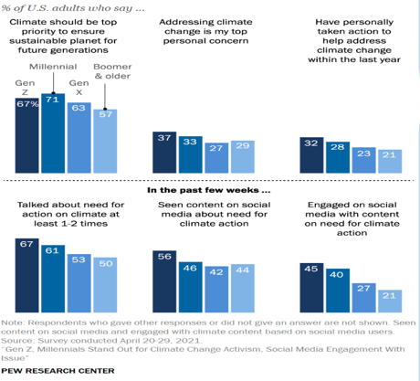
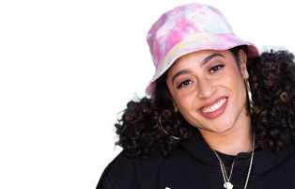
Gen Z & Millennials are more active that older generations addressing climate change.

Slide 13
The Vision:
LATV celebrates Earth Day for an entire week with original specials, segments, and content around Latinos who are living La Vida Green and contributing to a more sustainable future.
Ride along with LATV as we take a journey in our environmentally friendly EV to visit three Latinx advocates who are helping make the world a greener place.

Slide 14
LATV’s Earth Day Special
Airdate: Saturday, April 22, 2023
Platforms: LATV Linear, LATV+ App
Run Time: 1-hour
Description: Hosted by LATV’s own Humberto Guida, the La Vida Green 1-Hour Special will showcase three Latinos who are working hard to create a cleaner more sustainable tomorrow through environmental non-profit work, art and expression, and innovation.
This edgy and exciting adventure into “the green life” will inform and inspire our viewers to make their own impact on sustainability in their communities.
Sponsorship Opportunities:
Title Sponsorship
Branded Promos
Product Integrations
Branded Custom Vignettes
Talent Mentions
Billboards and Lower 3rds

Slide 15
La Vida Green Digital Segments:
Airdates: April 17th, 19th, 21st, 22nd, 2023
Platforms: LATV.com
Run Time: 3-5 minutes each
Description: During the week leading up to Earth Day, we will publish 4 original La Vida Green video segments on LATV.com through our custom video player. LATV will feature profiles and stories of Latinos making an impact on sustainability, informative segments with facts and stats to live a greener life, and segments around artistic expression inspiring sustainability.
Sponsorship opportunities:
Title Sponsorship
Branded Promos
Display Units

Slide 16
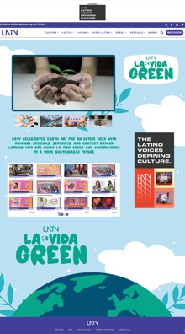
LATV.com/LaVidaGreen MicrositeHub
Profiles of featured Latinos in sustainability
Links to nonprofits
A marketplace of sustainable Latin-owned brands
User-generated content & giveaway of Latino-owned sustainable products
a custom video player featuring all La Vida Green Segments
La Vida Green articles on sustainability
Sponsorship Opportunities:
Branded Microsite Takeover
Custom Branding on La Vida Green Player
Pre-roll / Mid-roll
High Impact Ad Units

Slide 17
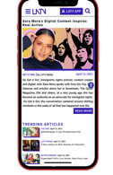
La Vida Green Social
Flight dates: April 05th - 22nd, 2023
Platforms: Instagram, TikTok, Pinterest
Description: LATV’s La Vida Green campaign will be promoted on all LATV’s social media handles as well as the accounts of talent and influencers involved. This includes:
Viral challenges and influencer content around sustainability
Posts promoting La Vida Green
Posts promoting Latino-owned sustainable small businesses
Posts promoting giveaway

Slide 19
LATINO ALTERNATIVE SUMMIT
(2 DAY EVENT + 1 HR SPECIAL)
Features Latino entrepreneurs and small business owners in the below categories.
5-min segments will air on primetime throughout HHM
Two Day in person event at LATV studios in Los Angeles
1-Hour Special
Hosted by our very own and diverse LATV talent, the two-day networking event will include a cocktail hour, performances, panels, interviews and many surprises, directly filmed from our State-Of-The-Art studios in Los Angeles, CA, where four of our main primetime shows stages will be built to have an exclusive experience for the entrepreneurs and will culminate with a one hour special.
COMEDY SPECIAL GRAND FINALE COMEDY 1-HOUR SPECIAL BREAKDOWN
Checkitow will air four (5min) segments throughout the month highlighting the comedians who will be on the TV special.
1-Hour TV Stand-Up comedy Special

Slide 20
This Hispanic Heritage Month, LATV is launching the Latino Alternative Business Forum, a two-day in person event where we will amplify Latino business leaders, small business owners and thought leaders through:
Latino Thought Leader Reception (Sept 15th)
Expert Panels, Think Tanks, and Content Creation (Sept 16th)
Throughout the two-day forum we will be capturing and creating engaging content that will air on a 1-hour Latino Alternative Business Special that will air on LATV during Hispanic Heritage Month.
MICROSITE
Promotional clips, short form digital content and the 1-hour special will also live on a custom microsite on LATV.com along with links to Latin-owned brands and products.

Slide 21
Julissa Arce
Writer
IG @julissaarce
44.K
Ana Flores
Founder/CEO
IG @weallgrowlatina
247K
Mike Alfaro
Creator
IG @millennialloteria
92.9K
Julissa Prado
Founder
IG @risocurls
318K
Rebecca Alvarez
Founder
IG @thebloomi
26.3K
Mando Fresko
CEO
IG @mandofresko
258K

Slide 22
SPONSORSHIP OPPORTUNITIES
LATINO ALTERNATIVE
BUSINESS SPECIAL
EVENT IN-PERSON
Latino Thought Leader Reception (Sept 15th)
Branded Set Sponsorship
During the reception LATV hosts will have 1-1 interviews with guest Thought Leaders on a
branded set.
Bar Sponsorship
The bar, napkins and drinks will feature branding.
Expert Panels, Think Tanks and Content Creation (Sept 16th)
Panel Sponsorship
The “Money Moves” panel about achieving financial freedom and stability moderated by Natalia Torres Haddad will be brought to you by.
Segment Sponsorship:
The “Money Moves” panel will be edited into an informative segment brought to you by. We will include a host mention in the intro, lower 3rds and billboards.
Custom Content Sponsorship:
A fun and informative segment titled “Financially Fly” hosted by a Latina influencer will give our audience tips on how they can plan their financial future. The segment will include the services and features.
ADDITIONAL OPPORTUNITIES
:30 Custom Vignettes
We will create custom 30 second vignettes with messaging to air during LATV programming, and as pre-roll on HHM content on LATV.com.
Microsite Sponsorship:
The Latino Alternative Business Microsite will prominently feature branding and creative.

Slide 24
Latino Alternative TV is a Certified Minority-Owned independent TV network and media company amplifying the Latino voices redefining culture through award winning original bilingual content available on all screens and platforms loved by our community.
Made up of LGBTQ+ professionals including producers, creators, and even our CEO Andres Palencia, LATV has a legacy as an ally and resource for the LGBTQ+ community.
“Being a platform of genuine Latino expression means we must empower and celebrate LGBQT+ pride throughout the whole year. You’ll see LGBTQ+ professionals throughout our business, creating and appearing in LATV content throughout the year. We welcome you to join us in honoring Pride month by partnering with LATV on our Mas Que Pride campaign.”
Andres Palencia CEO, LATV

Slide 25
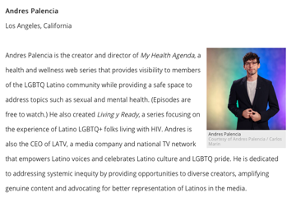
LATV’s LGBTQ+ Distinctions:
The first Latine LGBTQ+ Talk Show: Glitterbomb on LATV (2018)
The first Trans talk show host: Juliana Joel (host of The Q Agenda on LATV)
The Q Agenda on LATV Awarded 2020 BLADE Magazine Best of LGBTQ
LATV’s CEO Andres Palencia Awarded Poz Magazine’s “Poz 100 in 2022”
The Q Agenda on LATV Awarded Out Magazine's “Out 100 in 2022”

Slide 26
This June, LATV’s Mas Que Pride campaign will uplift and empower our Latine LGBTQ+ Familia to feel strength and Pride from their culture and identity so they can live as their best and most genuine self.
Original Mas Que Pride content produced by Latine creators who mirror their community includes short and long form video, articles and social content around LGBTQ+ entertainment, health, lifestyle, comedy and the heroes we look up to.

Slide 27
Mas Que Pride content will live across all LATV distribution and includes:
A 1-hour Mas Que Pride Special (TV & LATV+ App)
Mas Que Pride short-form video series (LATV.com digital exclusive)
½ hour My Health Agenda special (TV & LATV+ App)
Season 9 premiere of The Q Agenda (TV & LATV+ App)
Series Premiere of Trans-lead variety series Royal-T (TV & LATV+ App)
Series Premiere of LGBTQ+ Lifestyle series Head to Soul (TV & LATV+ App)
Season 2 Premiere of Living y Ready (LATV.com digital exclusive)
Mas Que Pride themed segments and Specials within other LATV programming TBD
A LATV.com/MasQuePride microsite on LATV.com

Slide 28
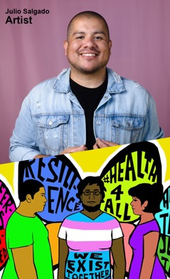
Mas Que Pride 1-hour Special
Air Date: June 01, 2023
Platforms: LATV Broadcast, LATV+ App
Description: Our Pride month celebration kicks off with a 1-hour Pride special airing on LATV primetime and available exclusively on the LATV+ App. With a focus on the aspects of us that LGBTQ+ Pride inspires like purpose, art, sense of belonging and advocacy, this special will give deeper meaning and bring a sense of joy to Pride month.
Taped in front of a live audience at our studios in LA features LATV’s award winning talent, celebrity guests, and a special acoustic performance as well as a sneak peek at the new original LATV LGBTQ+ content.
Mas Que Pride Short form Video Series
4x 4 – 8-minute episodes weekly
Premieres: June 02
Platform: LATV.com Digital Exclusive
Description: Each episode of the Mas Que Pride series highlights one member of the LGBTQ+ community who will share in their own words their sense of Pride and how that inspires them to be better and we will share examples of how that shows up in their chosen form of expression. We will learn how the LGBTQ+ personalities we look up to turned their challenges, insecurities and pain from growing up queer and transformed that into their form of expression.

Slide 29
Premiering on LATV this Pride month.
We celebrate Pride year-round through our LATV Queer content and this Pride month we’re excited to premiere new series of groundbreaking inclusive content as well as new series of favorite LATV series.
Series Premiere of LGBTQ+ Lifestyle series Head to Soul (TV & LATV+ App)
Season 9 premiere of
The Q Agenda
(TV & LATV+ App)
Season 2 Premiere of
Living y Ready
(LATV.com digital exclusive)
Coming Fall 2023
Series Premiere of Trans-lead variety series Royal-T (TV & LATV+ App)

Slide 30
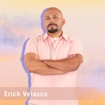
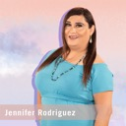
This June, LATV’s Mas Que Pride campaign will uplift and empower our Latine LGBTQ+ Familia to feel strength and Pride from their culture and identity so they can live as their best and most genuine self.
Original Mas Que Pride content produced by Latine creators who mirror their community includes short and long form video, articles and social content around LGBTQ+ entertainment, health, lifestyle, comedy and the heroes we look up to.

