Slide 1
Power your brand with our Freemium Ad-Supported Phone Service.
A FREE + PREMIUM app-based phone carrier, made possible by advertisers like you.

Slide 2
Free for all.
We are the largest Freemium Ad-Supported Phone Service in the US, partnering with brands to empower people with free texts and calls through the TextNow app.
With 10M active users (mostly Millennial and Gen Z), we strive to make communication more accessible so everyone can keep connecting with what and who they love every day.
Freemium Ad-Supported Phone Service, powered by your brand.

Slide 3
Disrupting the communications space since 2009, we’re an innovative start-up standing on solid ground.
Founded by two university students looking to save money on their phone bills, TextNow has been putting free phone service technology into the hands of people for over 14 years.
2009
2011-2016
2016 - 2020
2020-2023
The Launch
We took off from a small table in off-campus student housing.
The Mission
Expands
On to 1M active users and $1.5M raised.
Developing TextNow Wireless service, the first-ever full-service freemium wireless company.
The Business Model Comes To Life
100M downloads and indirect revenue focus and growth.
Launched Free Nationwide Talk & Text, a first-of-its-kind offering that provides ad-supported cellular service.
Where We Stand & Where We Want To Go
We’ve reached a 2x revenue growth of $110M and 10M active users.
We've kicked off direct sales efforts to continue expansion.
Freemium Ad-Supported Phone Service, powered by your brand.

Slide 4
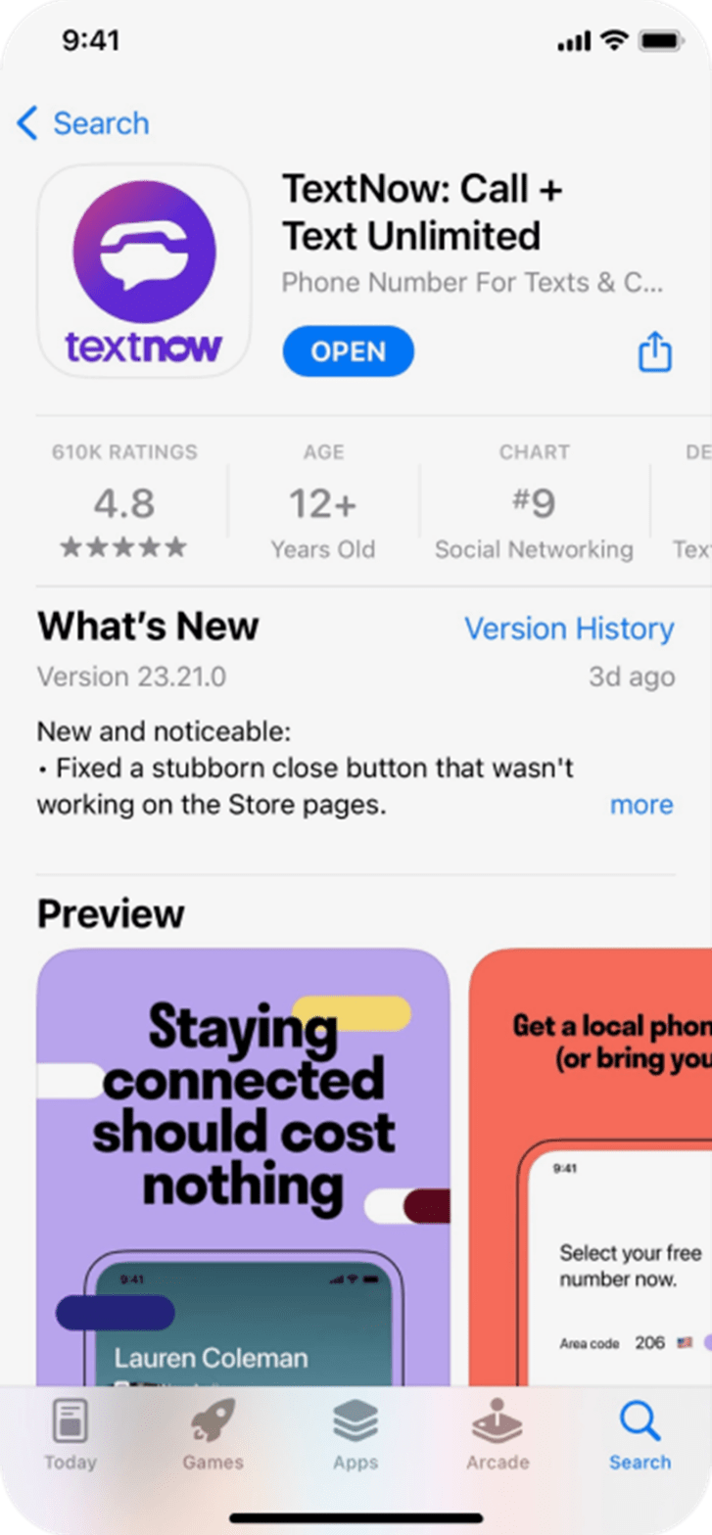
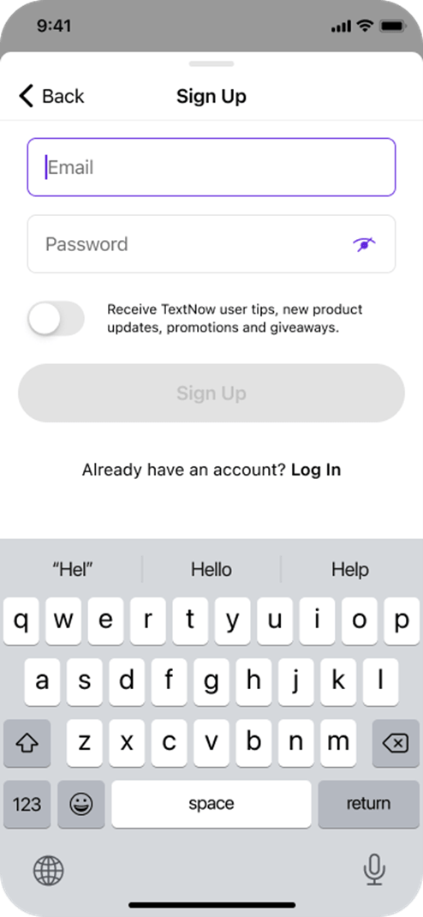
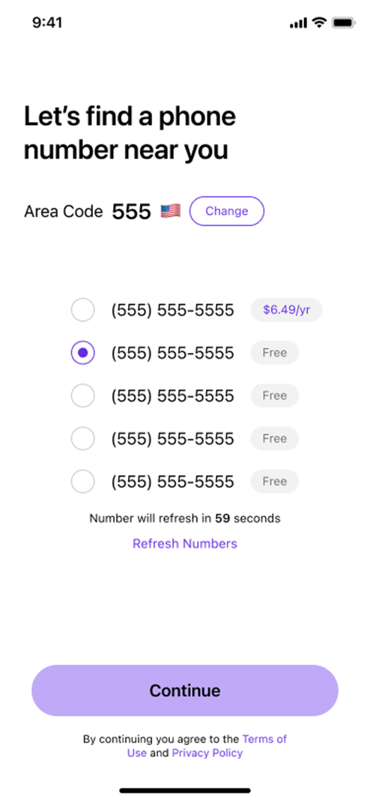
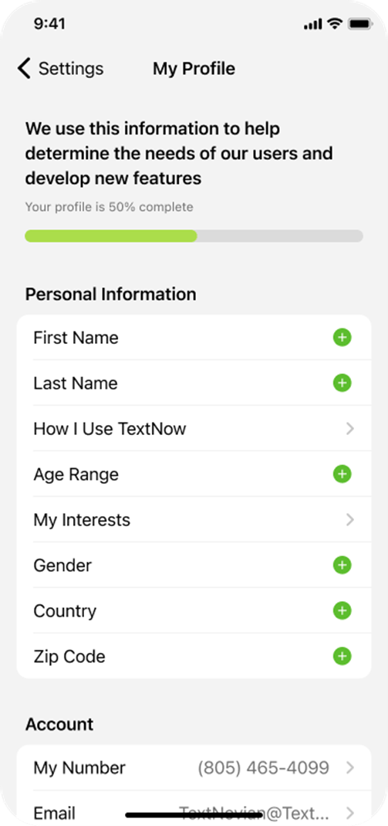
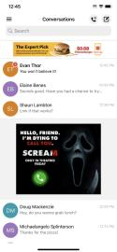
Want freemium phone service? We got you.
Our phone service is powered by one of the largest mobile networks in the nation.
Download the app.
Create a user profile.
Choose a free phone number.
Fill in your profile information.
Enjoy free phone service on the spot, powered by our advertisers.
Freemium Ad-Supported Phone Service, powered by your brand.

Slide 5
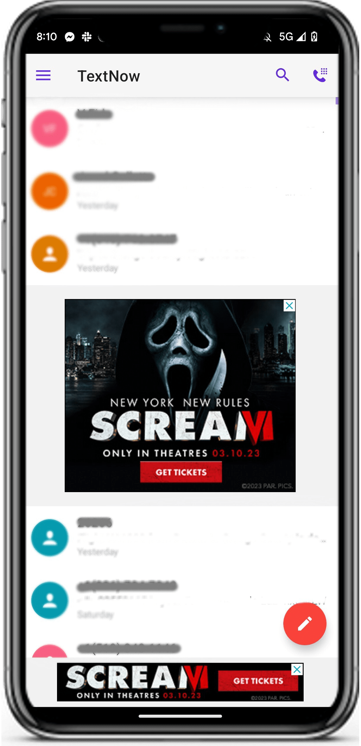
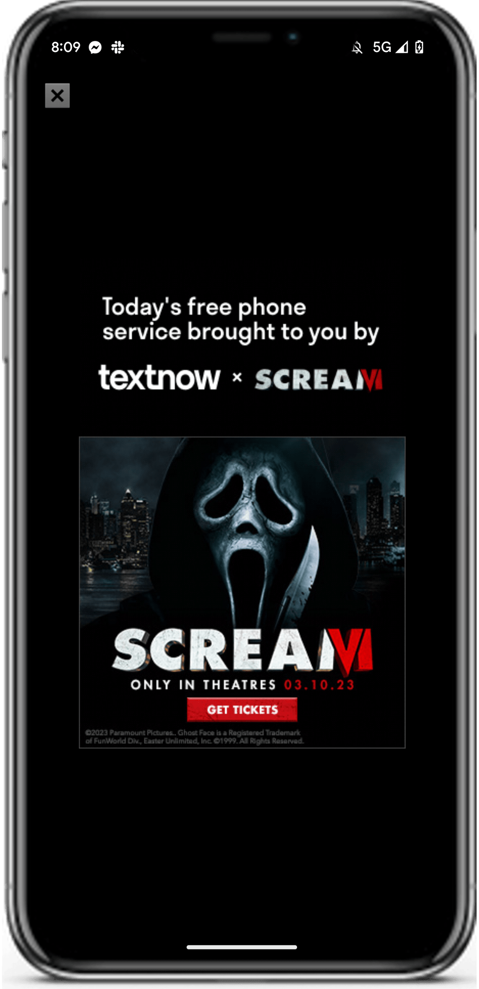
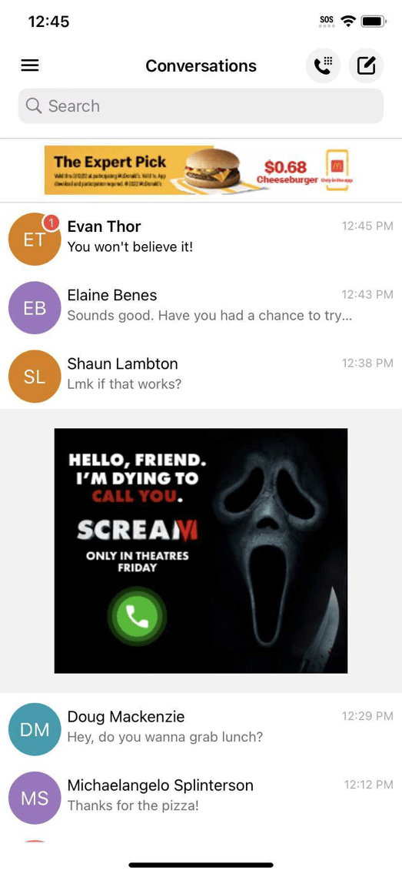
Enable freemium phone service for users without interruption.
By having ads integrated into the user’s daily experience
Upon opening the app (available for certain premium units)
Freemium Ad-Supported Phone Service, powered by your brand.

Slide 6
The TextNow community.
Connect with a hard-to-find, hard-to-engage audience, at scale.
Young and diverse
10M. Millennial and Gen Z – 72% of diverse backgrounds.
Influential
Forward-thinkers, ahead of the game (“the cord cutters of phone service”).
Savvy and bold
Smart spenders. They want the best phone service and don’t want to pay for it.
Hyper-engaged
Lean-forward attitude towards advertisers. Spend +23 mins/day in our app.
Freemium Ad-Supported Phone Service, powered by your brand.

Slide 7
Young, diverse and highly engaged.
72% Millennial + Gen Z of diverse backgrounds.
Urban Lifestyle
35-44: Male, Parent, Rap & Hip Hop Fans, Fast Food Cravers.
Music Enthusiast
Female, Pop Music Fans, Rock Music Fans.
Hardcore Gamer
18-24: Male, Single, Luxury, Personal Care Enthusiast, Hardcore Gamers.
Food is Culture
18-34: They connect with cultures and their world through food and beverage experiences.
Young Parents
Young parents who prioritize the health and happiness of their families and convenient and culturally-relevant ways.
Demographics Parent
25-34
Audience Affinity
Foodies, on-the-go consumers, travelers, adventure seekers
Demographics Male & Female
18-44
Audience Affinity
Price-Conscious
Digitally Savvy
Online Reviewer
Demographics Male Parent 24-44
Audience Affinity
Hip-Hop Street culture Trends Fast Food Craver
Demographics Female
Audience Affinity
Pop Music Fan
Rock Music Fan
Demographics Male Single
18-24
Audience Affinity
Hardcore Gamer
Freemium Ad-Supported Phone Service, powered by your brand.

Slide 8
Our audience is as diverse as America is today (or more, depending on the age group!).
Ethnicity
Age
Gender
45%
52%
3%
+72%
28%
Female
Male
Non-Binary
GEN Z
(Ages 13-24)
Millennial
(Ages 25-40)
GEN X
(Ages 41-56)
Freemium Ad-Supported Phone Service, powered by your brand.

Slide 9
A financially savvy community with meaningful spending power.
Over 62% of our users have a HHI above $50K.
% of TextNow users
# of TextNow users
Revenue ($m's) | 11% | 1.1M
GM (%) | 27% | 2.7M
Expenses ($m's) | 22% | 2.2M
EBITDA ($m's) | 19% | 1.9M
Cash ($m's) | 21% | 2.1M
< 25K
$25K-$50K
$50K-$75K
$75K-$100K
$100K-$150K
Freemium Ad-Supported Phone Service, powered by your brand.

Slide 10
How are we different than our competitors?
In contrast to other freemium apps like Pandora and Uber, our service is essential.
Because we are mobile native, we are better than content publishers. People use us more, in a more engaged way, and for deeper reasons.
Unlike WhatsApp, we allow advertisers to reach our users. We also provide a phone line for users to call anyone (whether the receiver has TextNow or not).
We're bigger than other mobile carriers: 3x bigger than Mint and 2x bigger than Boost.
Freemium Ad-Supported Phone Service, powered by your brand.

Slide 11
Trusted by the top advertisers in the world.
Freemium Ad-Supported Phone Service, powered by your brand.

Slide 12
A unique mobile media offering.
Awareness
Conversions
Sponsored Multimedia Text
High-Impact Display
Push Notifications
Rich Media (including Video)
Premium Takeovers
Free Phone Service Sponsorship
AUDIENCE INTELLIGENCE (PRE-POST) AND CAMPAIGN PERFORMANCE ANALYSIS
Freemium Ad-Supported Phone Service, powered by your brand.
9

Slide 13
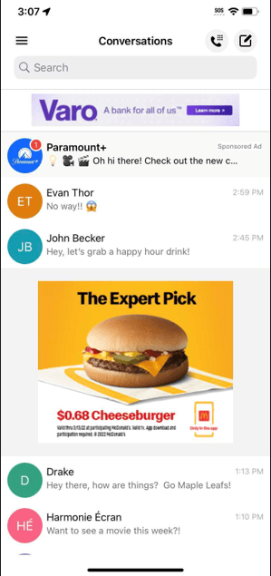
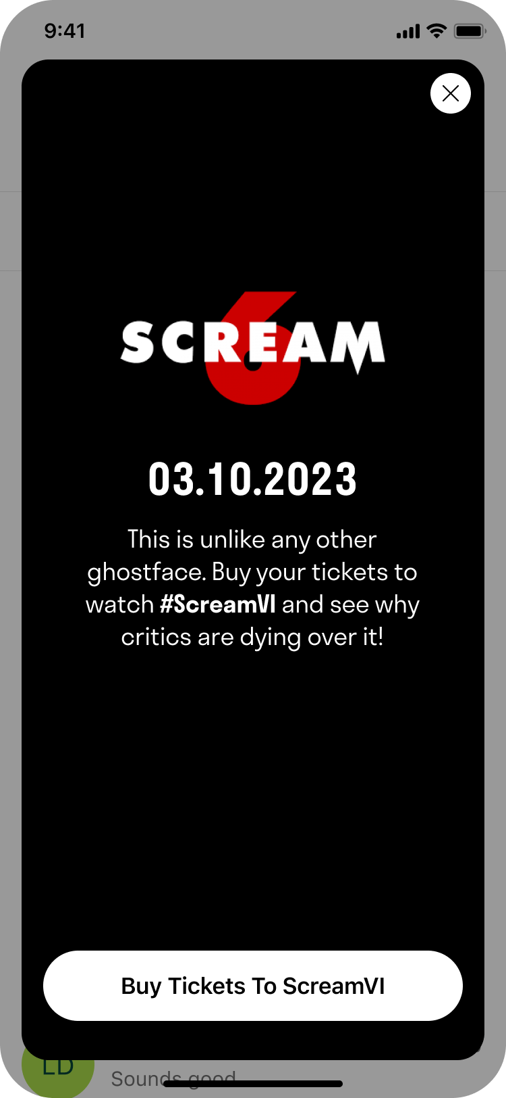
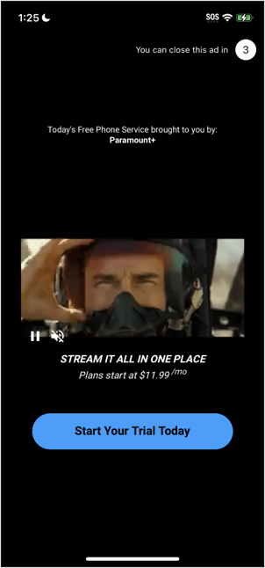
Sponsored multimedia message.
Awareness
Conversions
First-to-market innovation. Users get a message that shows as unread/native ad at the top of their inbox. Click detonates full takeover interstitial experience (static, audio or video). Accessible via CPM model. Same targeting capabilities as our premium products (geo, demographic, behavioral, interests, HHI, occupation, in-language – Eng/Spa).
Native text message
Clickable
Video
Full screen takeover
Static
Full screen takeover
Audio
Full screen takeover
Freemium Ad-Supported Phone Service, powered by your brand.

Slide 14
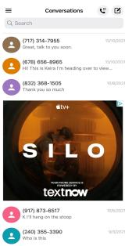
Free phone service sponsor.
Awareness
Features*
100% share of voice of a TextNow user’s 24-hour app experience.
Exclusive custom creative units.
Targeted audience of your choice.
Optimization through flight.
Supports creative rotations, custom native and text.
The user sees 50% less ads in general, which is perceived as a high value benefit attributed to your brand. Build brand love, equity and loyalty with this execution!
*TextNow users will be targeted for Sponsorship 1x during Sponsorship flight; each targeted user’s Sponsorship experience lasts for 24 hours.
Freemium Ad-Supported Phone Service, powered by your brand.

Slide 15
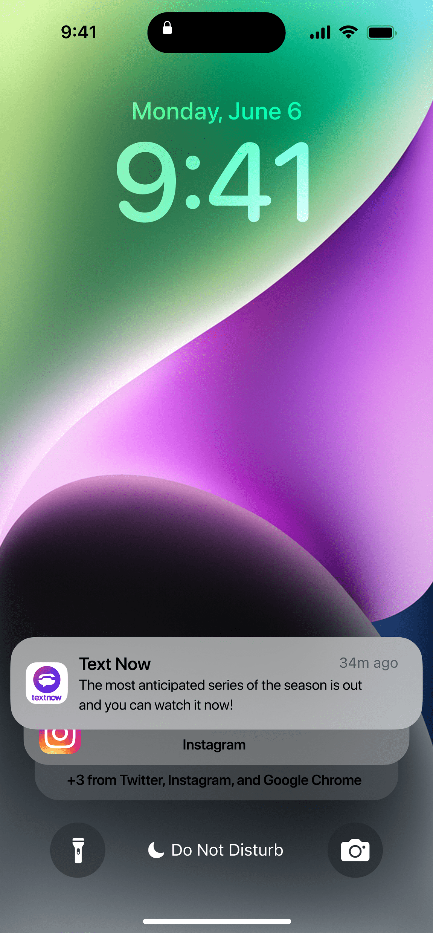
Push Notifications.
Awareness
Conversions
Features
Intimate and high-performing unit that “knocks at the door” of a user who is ready to hear from our advertisers and take action.
This initiative will allow your brand to deploy a patterned sequence of push messaging posts to TextNow’s community, with direct CTA to preferred brand actions and destinations.
Sent to users who have opted-in to listen from brands.
Freemium Ad-Supported Phone Service, powered by your brand.

Slide 16
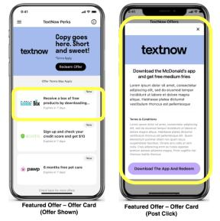
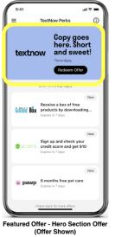
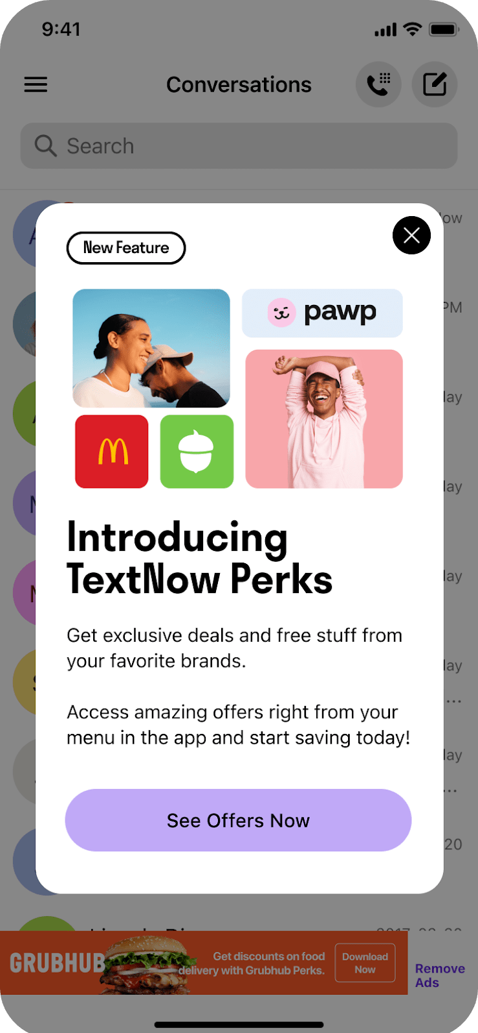
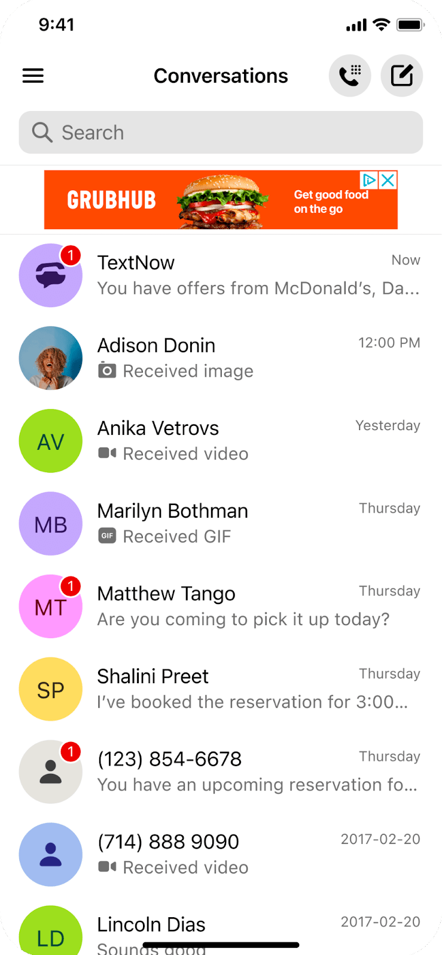
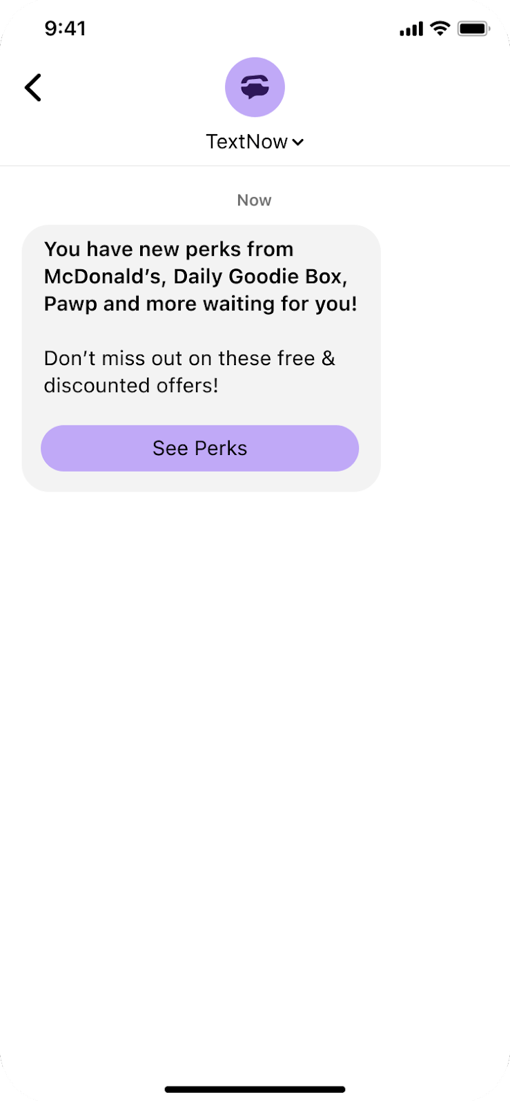
TextNow Perks (our very own offer wall).
Conversions
Awareness
TextNow Perks is a one-stop-shop, easy-to-navigate marketplace within the TextNow app, where users can find and redeem exclusive deals and offers from our partners.
TextNow Perks will provide a less cluttered experience for TextNow users and a greater opportunity for brand partners to reach our audience when they are in the right mindset.
How to find TextNow Perks in the app:
Features
Open the menu in the upper left corner of the screen.
Locate the bright yellow button titled “TextNow Perks”
Click the button.
TextNow Perks page opens.
We’ll make sure our users know what’s available in our wall through:
Interstitial take overs.
High Impact display.
In-app reminders (via conversation list).
Freemium Ad-Supported Phone Service, powered by your brand.

Slide 17
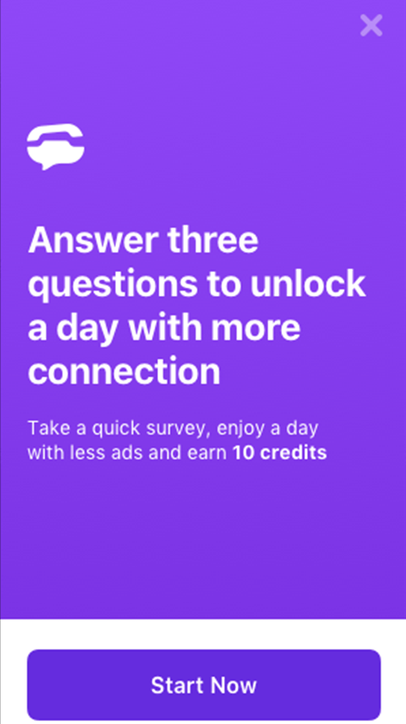
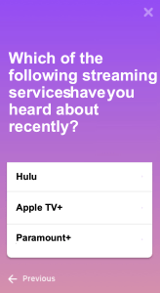
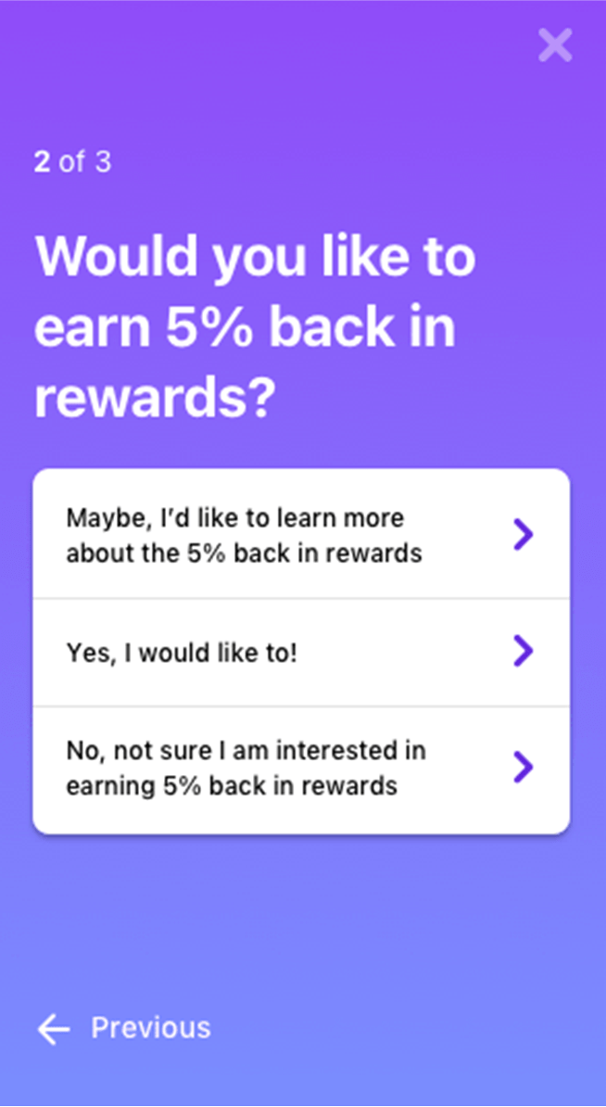
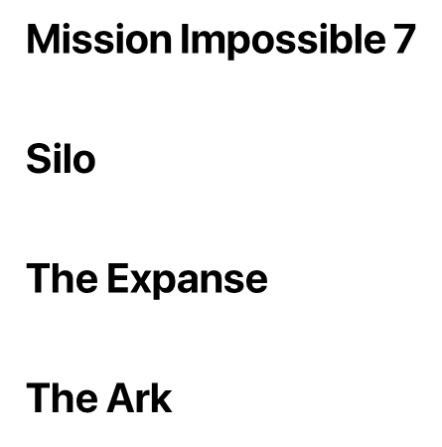
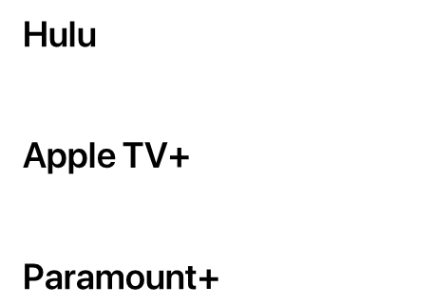
Custom brand lift survey.
Features*
TextNow brand research studies are 1st party driven. We engage with our users to help brands understand campaign impact in real-time, and we capture overall user behaviors based on your needs and preferences. **Additional details on media plan.
Freemium Ad-Supported Phone Service, powered by your brand.

Slide 18
Delivering unparalleled results.
Awareness
#1 partner for aided awareness, CTR, time spent on site and new account registrations for certain partners.
Up to 10x CTR lift versus industry standards.
Above average combined performance on video (both +75% completion rate AND + 4% on CTR on same units).
Conversions
45x ROI on sales.
#1 cost per new user sign-up.
#1 redemption rate from all partners supporting registration to loyalty program.
23¢ cost per store visit (20% brand new customers).
Bringing in customers who had not stepped foot in the QSR restaurant chain in the past 12 months.
Freemium Ad-Supported Phone Service, powered by your brand.

Slide 19
Join the free phone service
Engage a highly desirable hard-to-get audience at scale and drive measurable, unparalleled results through our unique full-funnel offering.
revolution.
Freemium Ad-Supported Phone Service, powered by your brand.

Slide 20
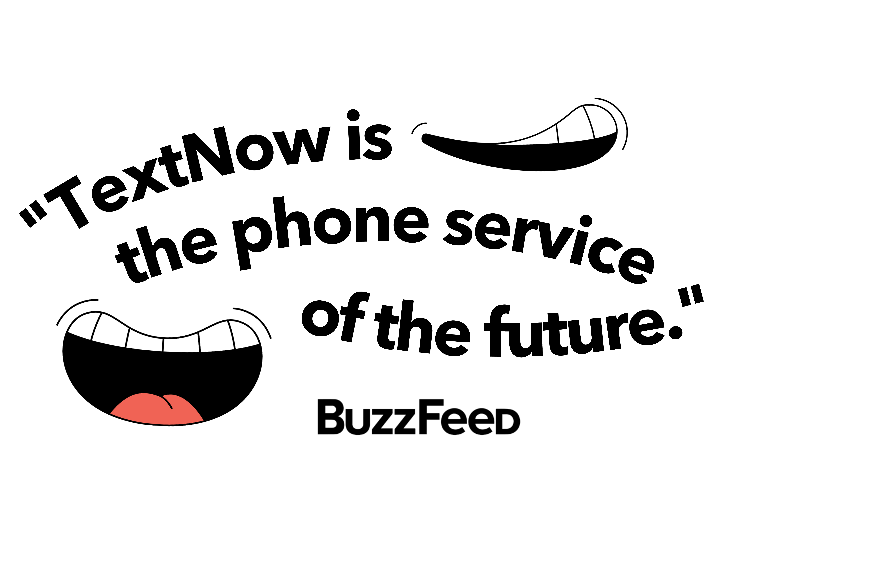
Freemium Ad-Supported Phone Service, powered by your brand.

Slide 21
“TextNow will be the next Unicorn company. They crossed 100M in revenue without having to overspend, and might be ready for an IPO soon.”
Freemium Ad-Supported Phone Service, powered by your brand.

